Slide 1
Intro to DEEP learning & Computer Vision
Ehab Sabry Fergany
Ahmed Fahmy

Slide 2
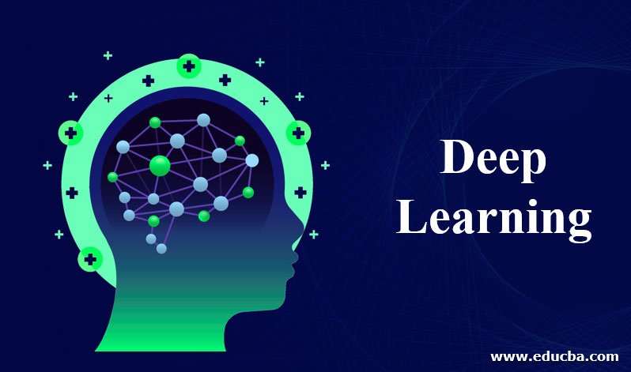
What is the deep learning

Slide 3
Deep learning
Deep learning is a subfield of machine learning that focuses on the development and implementation of artificial neural networks with multiple layers, allowing the model to learn and extract intricate patterns and representations from complex data. It is inspired by the structure and function of the human brain.

Slide 4
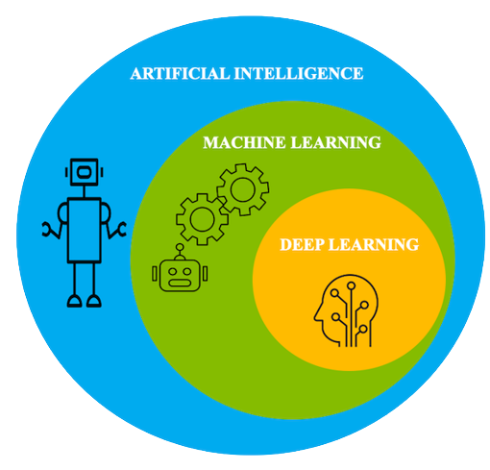

Slide 5
Human Vs AI

Slide 6
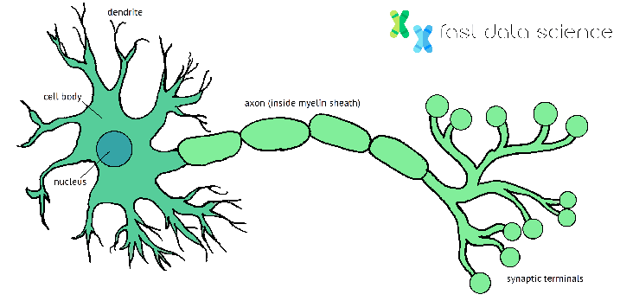
HUMAN neuron

Slide 7
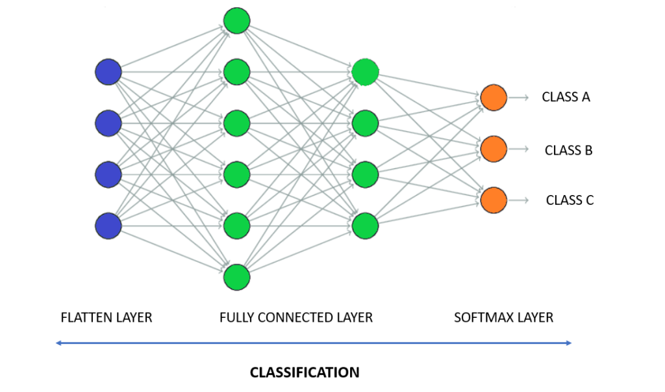
ANN

Slide 8
Challenges in Deep Learning
Data availability: It requires large amounts of data to learn from. For using deep learning it’s a big concern to gather as much data for training.
2.Computational Resources: For training the deep learning model, it is computationally expensive because it requires specialized hardware like GPUs

Slide 9
Challenges in Deep Learning
3.Time-consuming: While working on sequential data depending on the computational resource it can take very large even in days or months.
4. Overfitting: when the model is trained again and again, it becomes too specialized for the training data, leading to overfitting and poor performance on new data.

Slide 10
Deep Learning
Computer Vision
NLP

Slide 11
Image Processing

Slide 12
What is the Image processing
is the use of algorithms and mathematical models to process and analyze digital images. The goal of digital image processing is to enhance the quality of images, extract meaningful information from images,

Slide 13

Digital Images :
A digital image is an image composed of picture elements, also known as pixels, each with finite, discrete quantities of numeric representation for its intensity or gray level that is output from its two-dimensional functions fed as input by its spatial coordinates denoted with x, y on the x-axis and y-axis, respectively

Slide 14
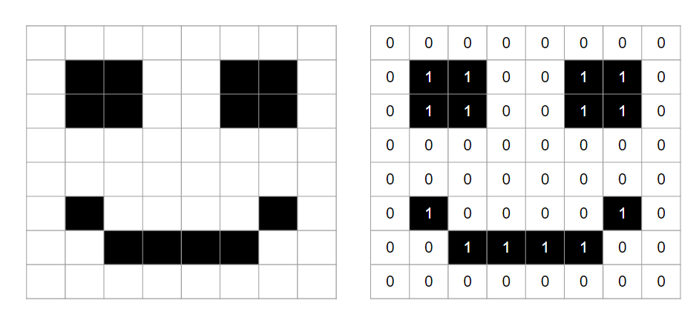
Binary Images :
one that consists of pixels that can have one of exactly two colors, usually black and white. Binary images are also called bi-level or two-level, Pixelart made of two colours is often referred to as 1-Bit or 1bit. This means that each pixel is stored as a single bit

Slide 15

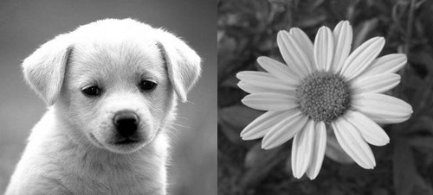
Grayscale images
grayscale means that the value of each pixel represents only the intensity information of the light. Such images typically display only the darkest black to the brightest white. In other words, the image contains only black, white, and gray colors

Slide 16
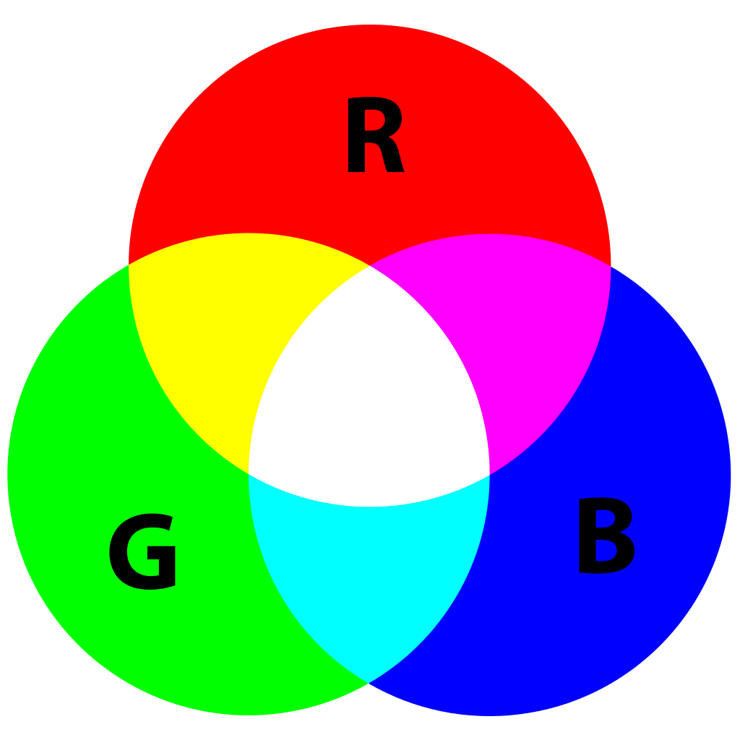

RGB Images :
RGB image, sometimes referred to as a truecolor image, is stored as an m-by-n-by-3 data array that defines red, green, and blue color components for each individual pixel.

Slide 17
Image Processing
1. Image Enhancement & Restoration
2. Image Segmentation
3. Edges Detections

Slide 18
Image Enhancement & restoration

Slide 19
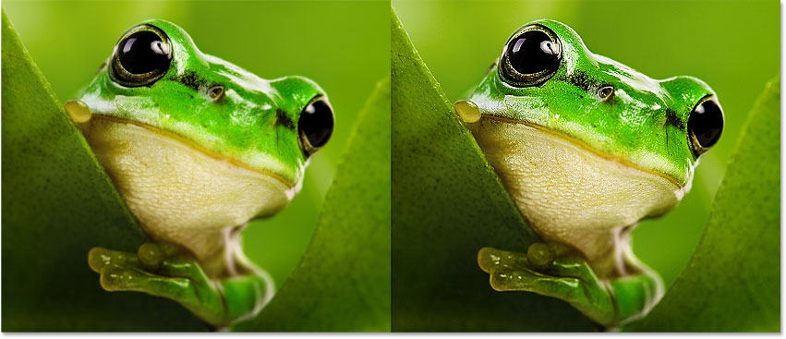
Sharpening
Sharpening techniques enhance the edges and fine details in an image, making them more visually pronounced. Common sharpening methods include unsharp masking, which enhances high-frequency components, and Laplacian sharpening, which enhances the edges.

Slide 20
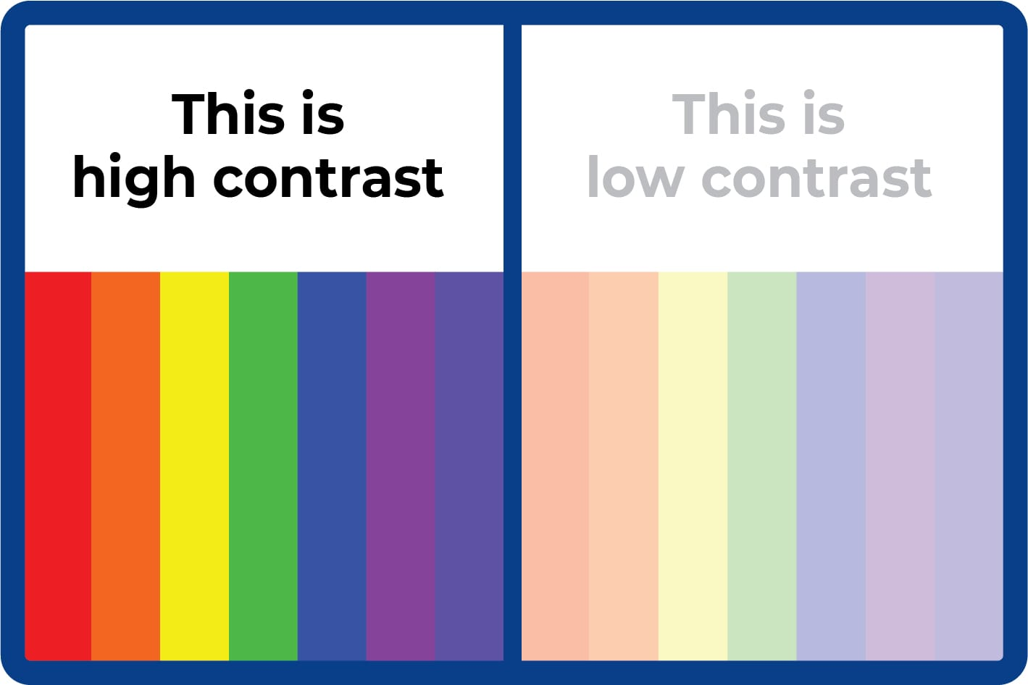
Histogram Equalization:
Histogram equalization is a method to improve the contrast of an image by redistributing the pixel intensities across the entire dynamic range. It stretches the histogram to cover the full intensity range, making the image more visually appealing.

Slide 21
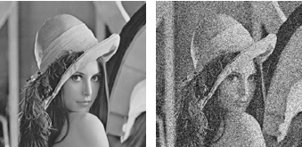
Noise Reduction
Noise reduction techniques aim to reduce unwanted noise or disturbances in an image. Techniques such as median filtering, Gaussian filtering, or wavelet denoising can be employed to smoothen the image while preserving important details.

Slide 22
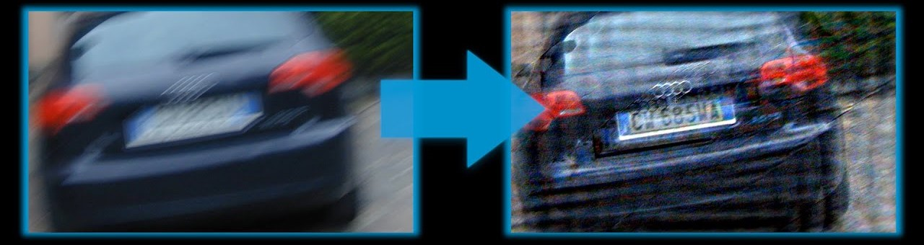
Deblurring
Deblurring techniques aim to reduce blurriness or restore sharpness in images caused by motion blur, out-of-focus blur, or other factors. Deconvolution-based methods, blind deconvolution, or specific algorithms designed for motion blur removal can be used to enhance the image clarity.

Slide 23
Image Segmentation

Slide 24
Image Segmentation
Image segmentation is the process of dividing an image into multiple distinct regions or objects based on certain criteria, such as color, texture, intensity, or other visual properties. The goal of image segmentation is to group pixels or regions with similar characteristics together and separate them from the surrounding background or other objects.

Slide 25
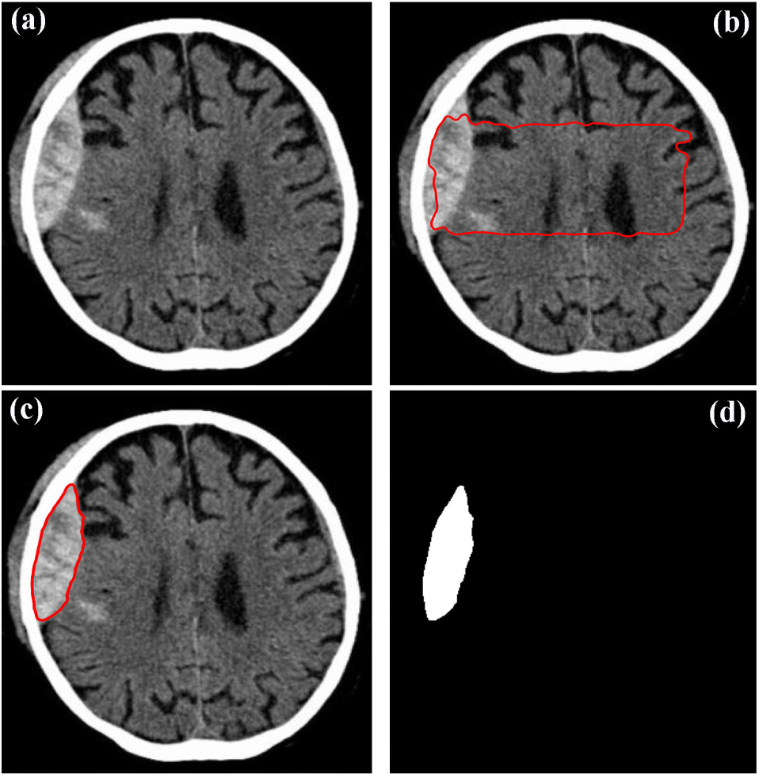
Thresholding

Slide 26
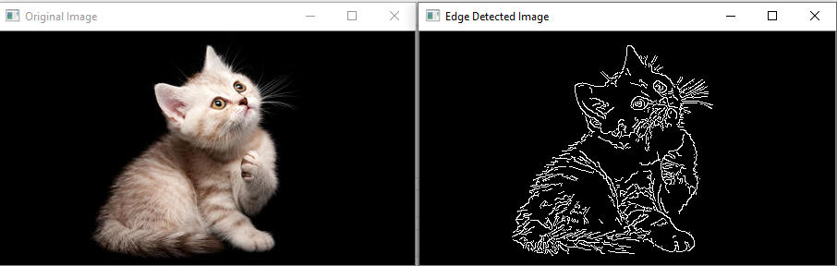
Edges Detections
Edge detection is a fundamental image processing technique that aims to identify and localize sharp transitions in intensity values within an image. Edges represent boundaries or regions of significant intensity changes and often correspond to object boundaries or other important image features. Edge detection is widely used in various computer vision tasks, including object recognition, image segmentation, and image analysis. Here are some commonly used edge detection algorithms:

Slide 27
Computer Vision

Slide 28
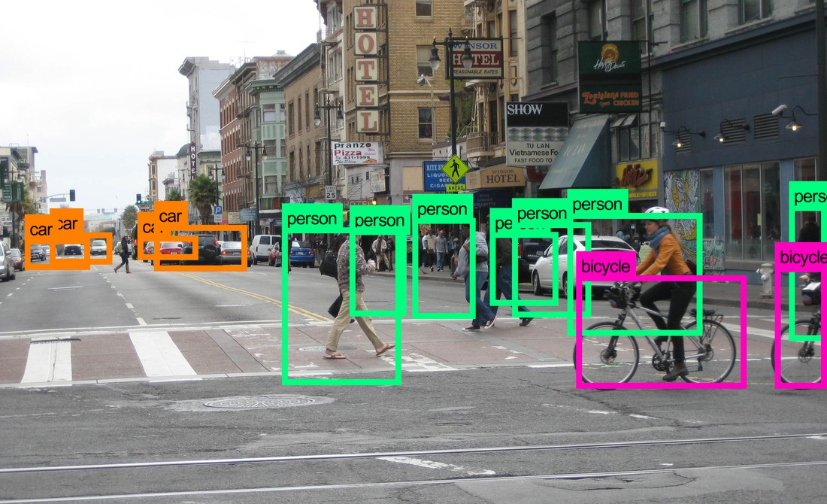
Computer vision
Computer vision (CV) is the subcategory of artificial intelligence (AI) that focuses on building and using digital systems to process, analyze and interpret visual data. The goal of computer vision is to enable computing devices to correctly identify an object or person in a digital image and take appropriate action

Slide 29
CV
Image Classification
object Detection
Image Segmentation
Video Analysis

Slide 30
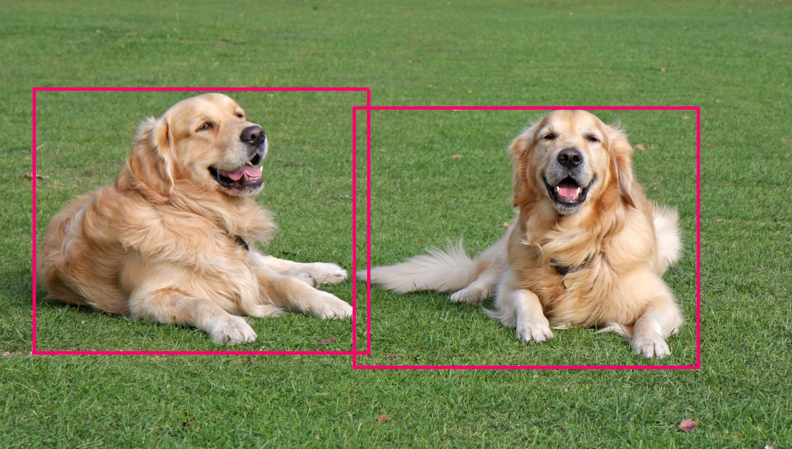
Object detection
Object detection is a computer vision task that involves locating and identifying objects of interest within an image or a video. Unlike image classification, which assigns a single label to the entire image, object detection aims to detect multiple objects and localize them by drawing bounding boxes around them

Slide 31
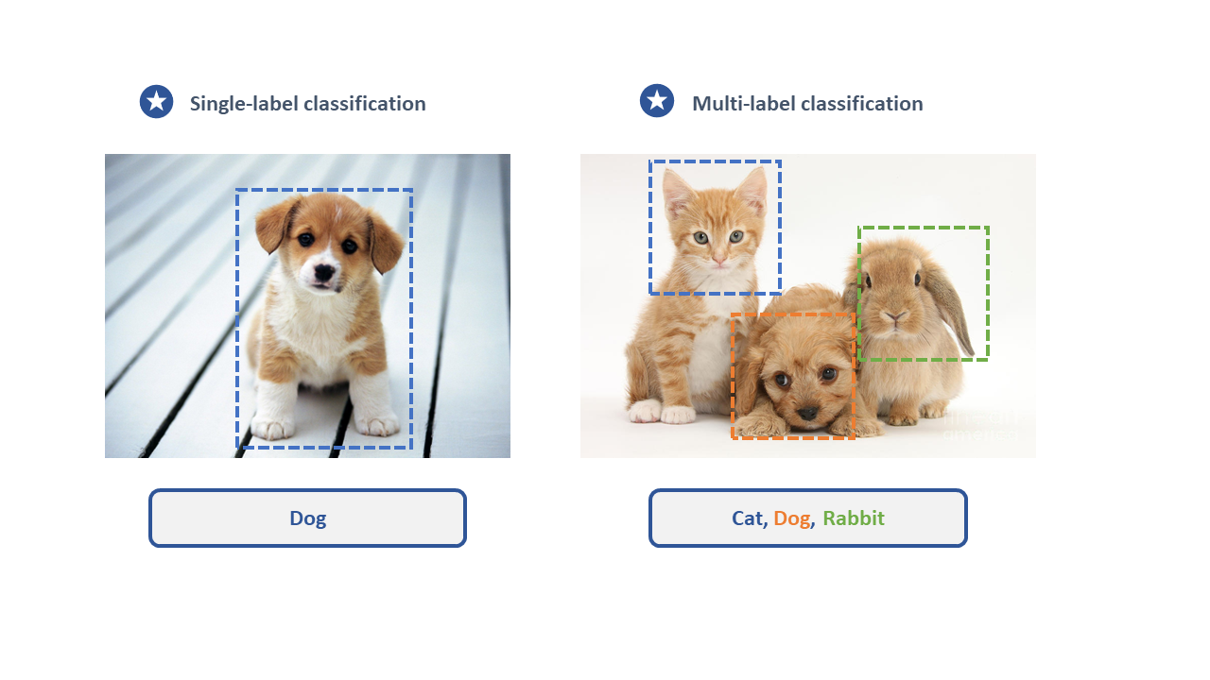
Images classification
Image classification is a computer vision task that involves categorizing images into predefined classes or categories based on their visual content. The goal is to develop a model that can accurately assign appropriate labels to unseen images. Image classification has numerous applications, such as object recognition, content-based image retrieval, scene understanding, and more

Slide 32
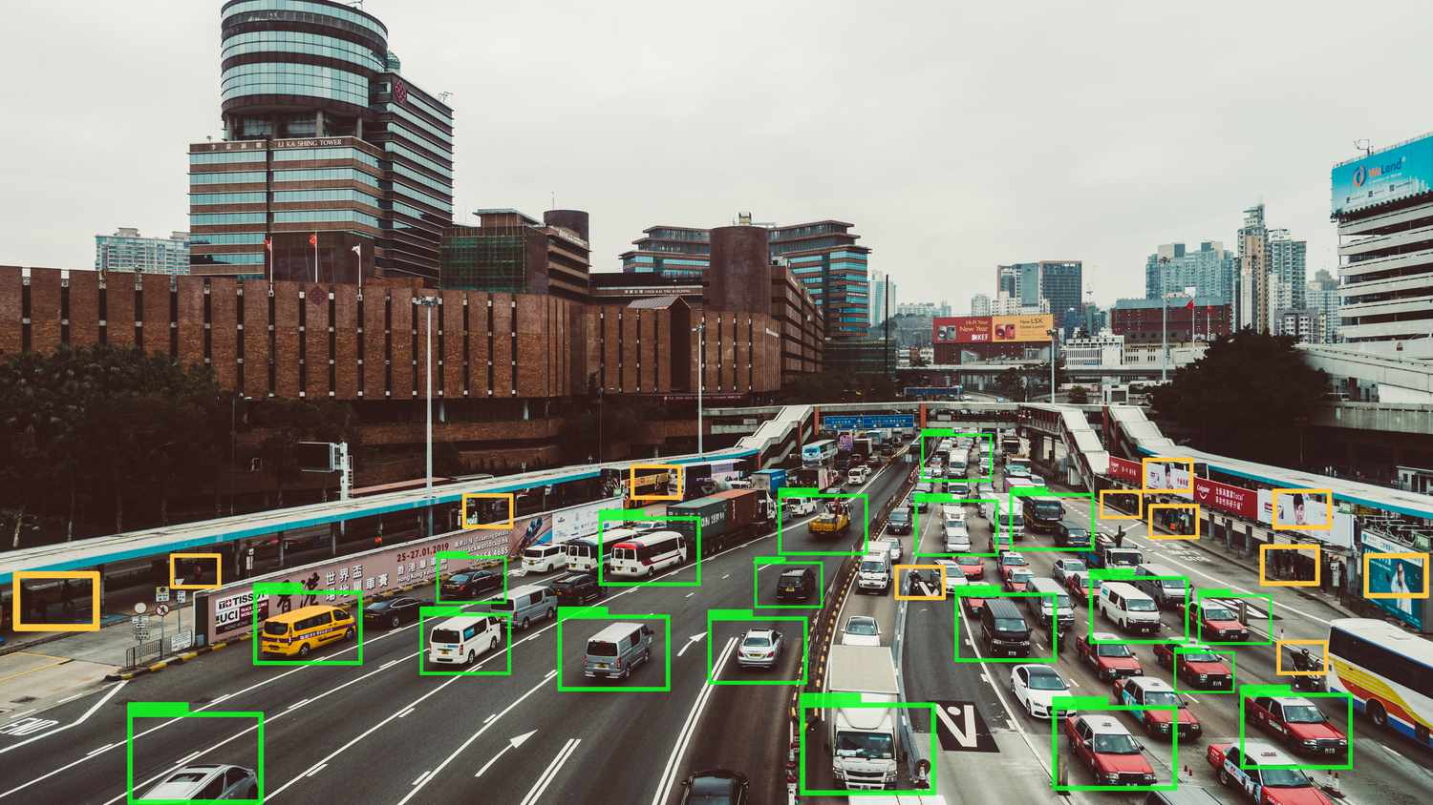
Video Analysis

Slide 33
CV application

Slide 34
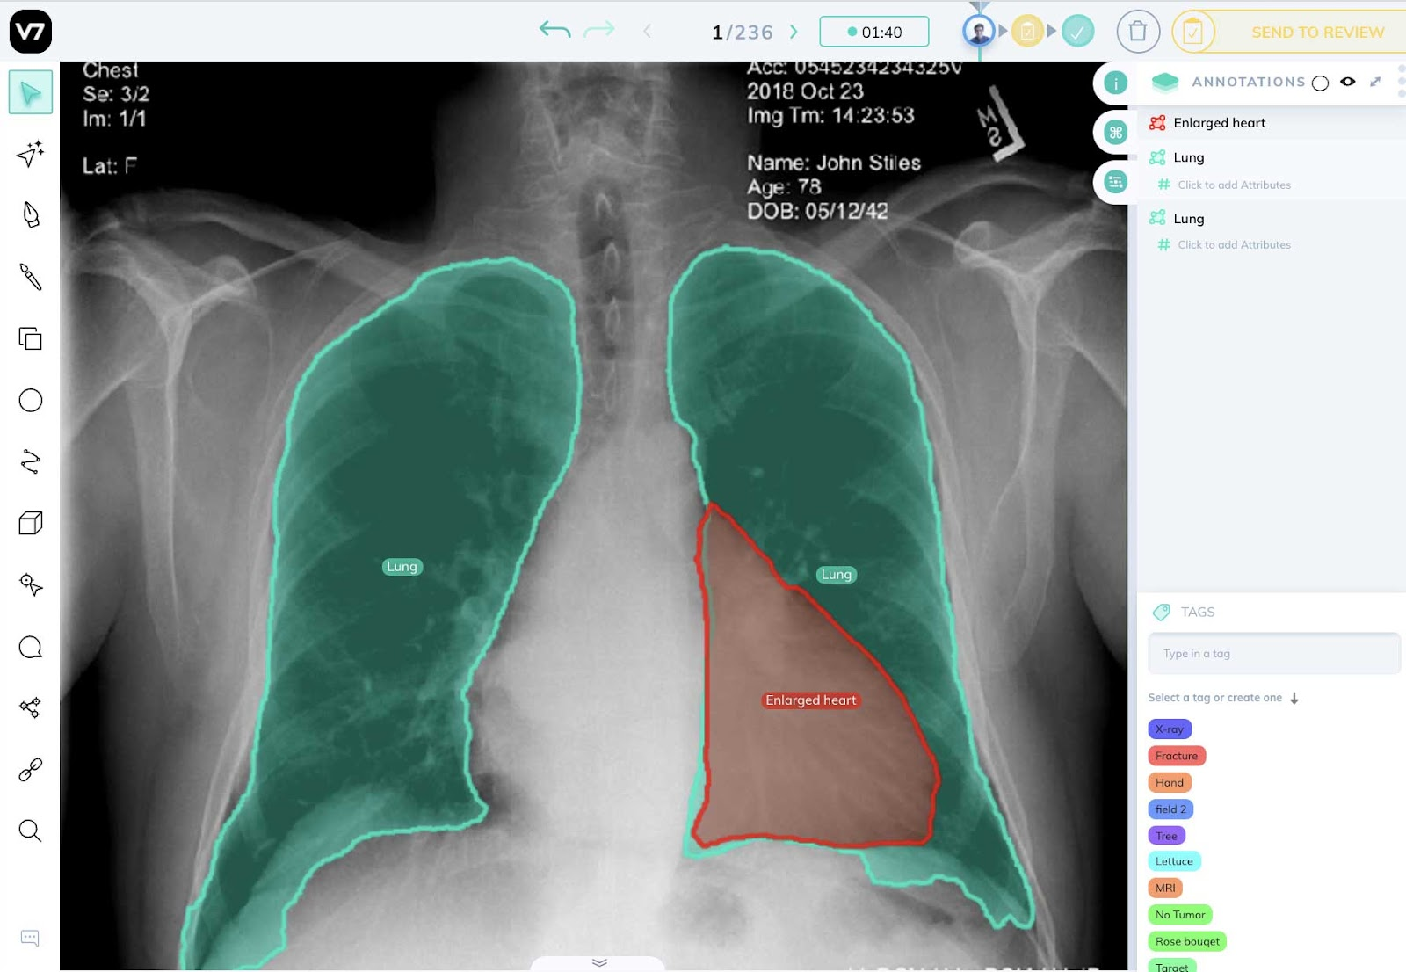
Medical Diagnosis

Slide 35
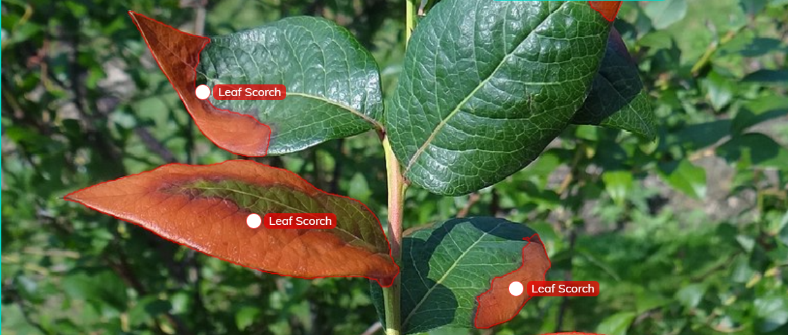
Agriculture

Slide 36
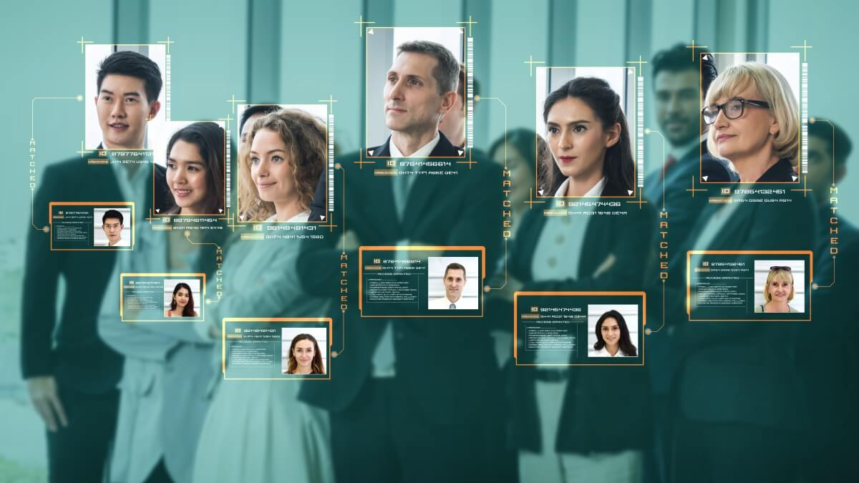
ATTENDANCE SYSTEM

Slide 37
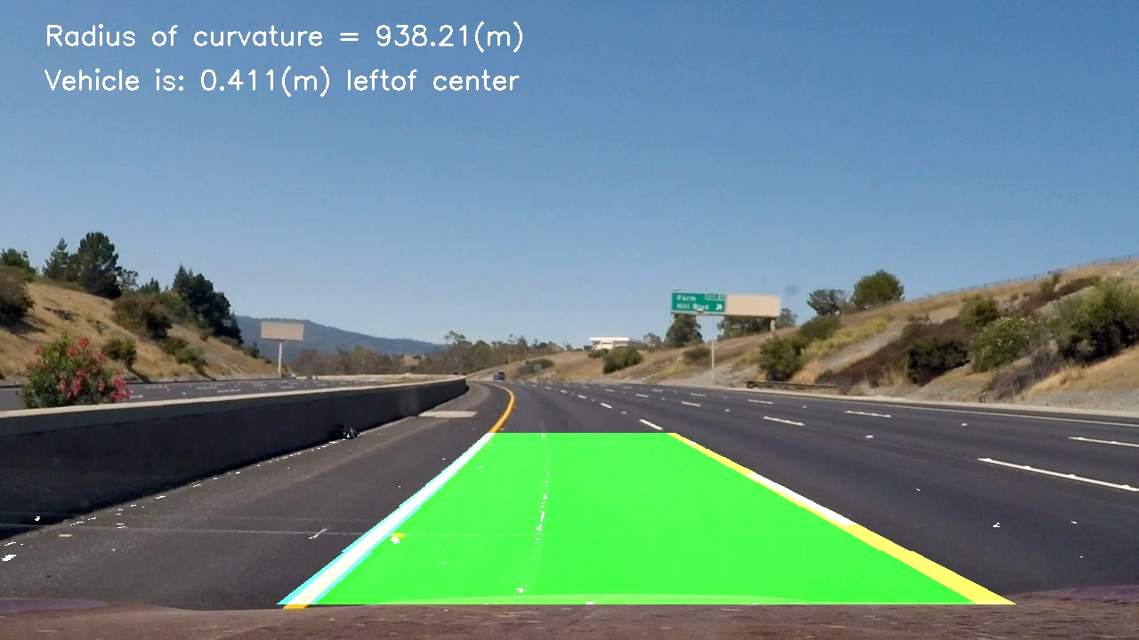
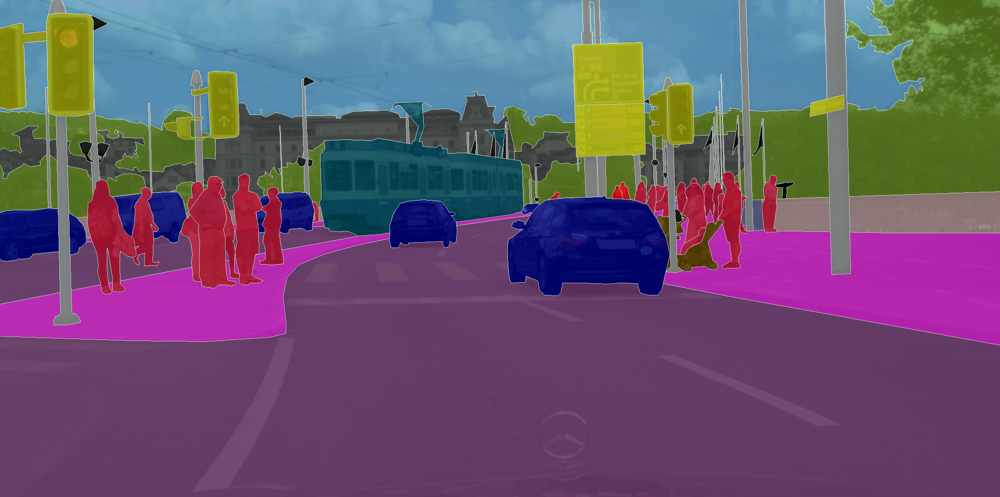
Self-driving CAR

Slide 38

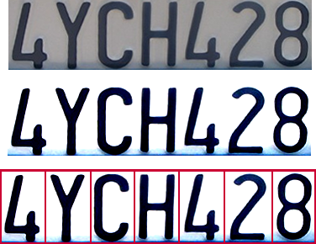
Optical character recognition (OCR)

Slide 39
Thank you
​

